Slide 1

Laboratory 5-6
Convolutional Neural Networks
& Overfitting
Master in Big Data Solutions 2020-2021 - Artificial Intelligence
Luis Salgueiro
luis.salgueiro@bts.tech

Slide 2

Reminder
Is this webinar being recorded?

Slide 3
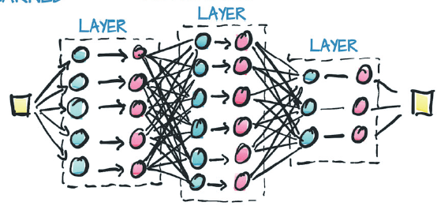
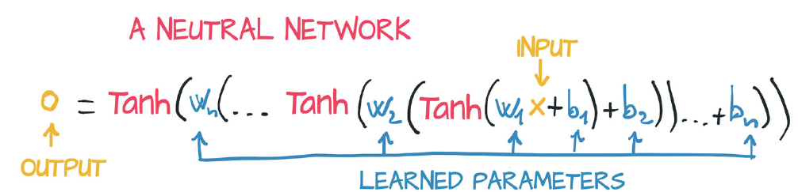
Multi-Layer Perceptron (MLP)
The connection of several perceptrons is called MLP.
The perceptrons are organized in groups called layers.
The mode in which the layers are connected is called architecture.
A MLP with 3 Layers.
Usually, the number of layers are referenced by the number of hidden layers.
Credits: Deep Learning with Pytorch. 2020
https://tex.stackexchange.com/questions/132444/diagram-of-an-artificial-neural-network

Slide 4
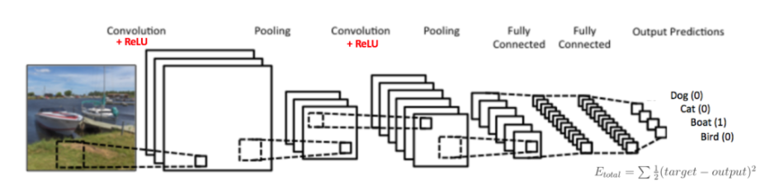
Convolutional Neural Networks (CNNs)
Credits: https://ujjwalkarn.me/2016/08/11/intuitive-explanation-convnets/

Slide 5
Agenda
In this lab exercises we are going to see:
How to define a CNN with Pytorch.
Differences between MLP and CNNs
Dataset transforms with torchvision.
How to deal with overfitting.

Slide 6
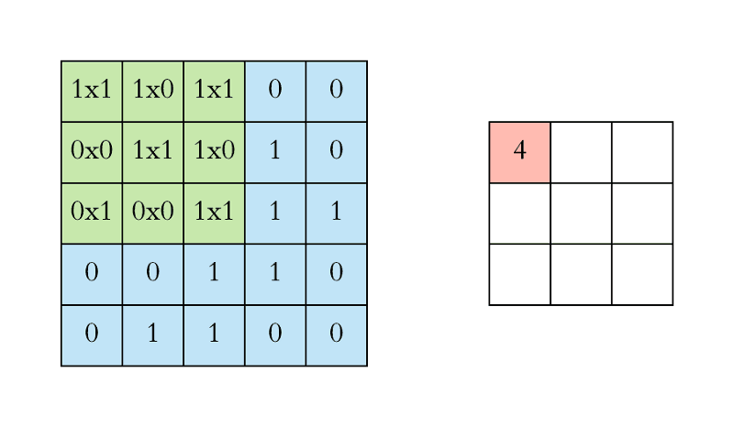
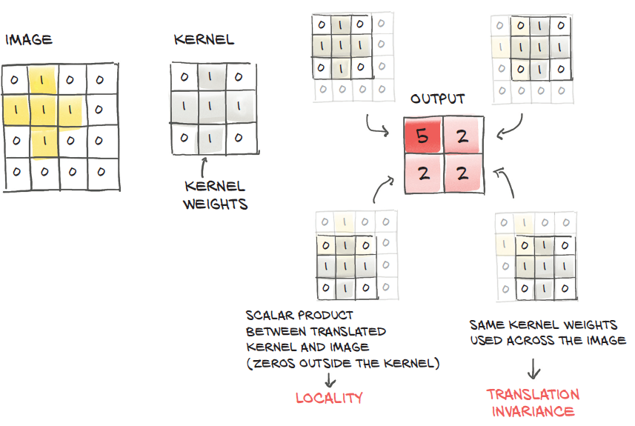

Convolutional Neural Networks (CNNs)
Credits: Deep Learning with Pytorch. 2020
https://www.freecodecamp.org/news/an-intuitive-guide-to-convolutional-neural-networks-260c2de0a050/
https://ujjwalkarn.me/2016/08/11/intuitive-explanation-convnets/
Notes:
Lets first discuss abou the basic stuff, the kernel that is an array (2d or 3d) that it will convolve sliding it with the entire image. So at each step it will ‘look’ a portion of the image. That is why the local property is about.
It wil take the correlation between the kernel and the local part of the image.
The way it will slide the image, that is, the amount of factor of sliding is another hyperparameter called the stride.
By this properties it is that the CNN has locality and translation invariance.

Slide 7
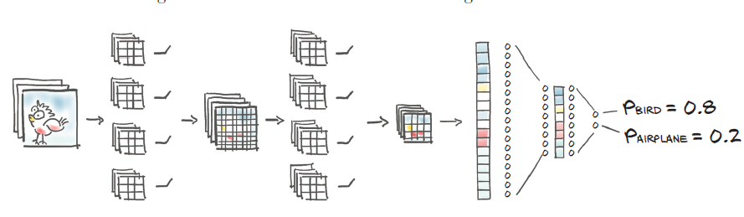
Convolutional Neural Networks (CNNs)
CNNs for classification
Feature extraction
Create a hierarchy of representative features learned from the image.
Classification MLP
Credits:
Credits: Deep Learning with Pytorch. 2020
Notes:
The features maps, created after the convolution with kernels, create different information about the image.
The network capacity is giving by the number of parameters defined in a network, and the network width, is the number of neurons per layer, in this case it will be the number of filters we use in each layer (output channel in a convolution layer).
The greater the capacity, more variability regarding the input the model will be able to manage, but at the same time is prone to overfit.

Slide 8
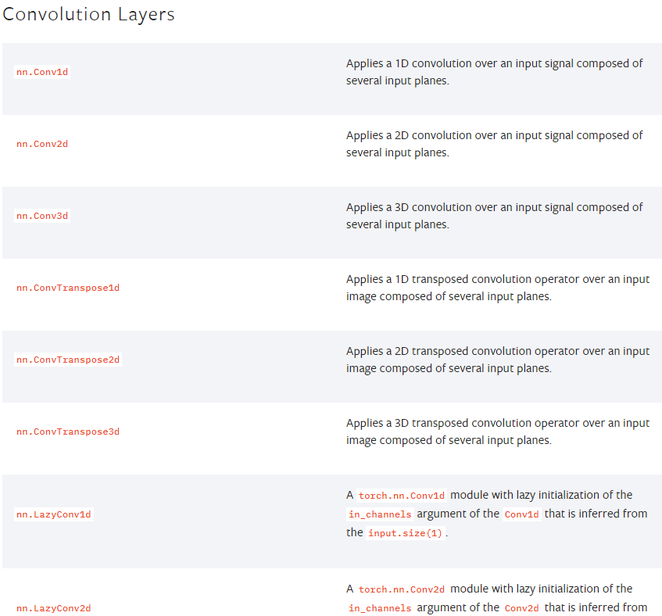
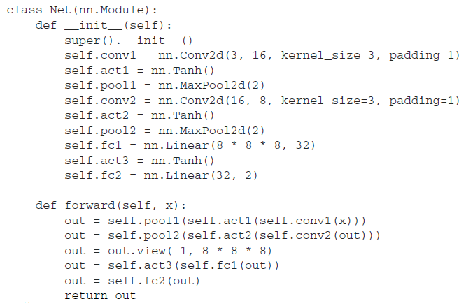
Convolutional Neural Networks (CNNs)
Pytorch → Torch.nn
Credits:
Credits: Deep Learning with Pytorch. 2020
Notes:
Pytorch has several functionalities that helps us to define properly the convolution layers, a well as maxpool and other layers that you will see along the course.
It is important to mention, that the linear linears, need to be defined specifically about the size of input and output neurons. This constraints a little the feature extraction part of the CNN, about the property that a conv-layer can convolve an image with any size.
So, in the forward part of the Network class, it is always present a .view(), that will arrange the tensor to have a shape of [BatchSize, in_features].
Sometimes, when a network is defined, it is necessary to debug first about the dimension of the image and in_features on the first linear layer.

Slide 9
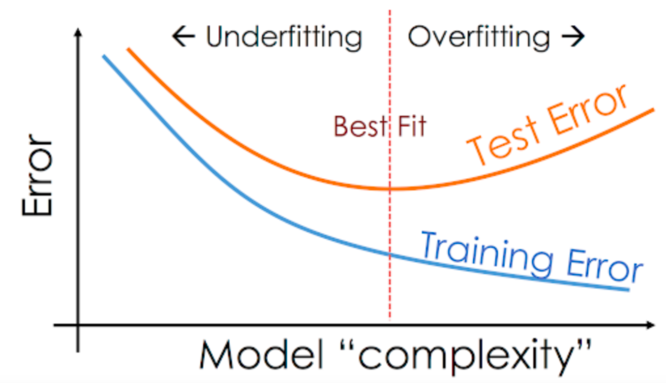

Overfitting
How do we find the right point for the best fit in our model?
Credits:
https://vitalflux.com/overfitting-underfitting-concepts-interview-questions/
https://twitter.com/silo_AI/status/1000254359148613632

Slide 10

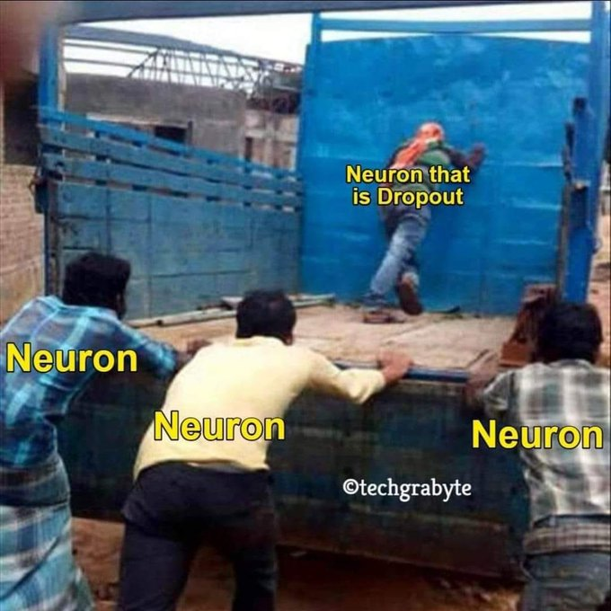
Dropout
“ A fully connected layer occupies most of the parameters, and hence, neurons develop co-dependency amongst each other during training which curbs the individual power of each neuron leading to over-fitting of training data.”
“Dropout forces a neural network to learn more robust features that are useful in conjunction with many different random subsets of the other neurons.”
Credits:
https://medium.com/@amarbudhiraja/https-medium-com-amarbudhiraja-learning-less-to-learn-better-dropout-in-deep-machine-learning-74334da4bfc5
https://twitter.com/ThomasScialom/status/1397108468255969282
Notes:
Zero out random neuros, where the randomization occurs at training iteration.
Perturbs features being generated by the model, exerting an effect is close to augmentation but this time for the network.
Placed between the nonlinear acivation function and the linear or conv layer sbsequent.
Note that is dropping out durng training, but in production or test, the dropout is bypassed or equivalently assigned a probability eual to zero.

Slide 11
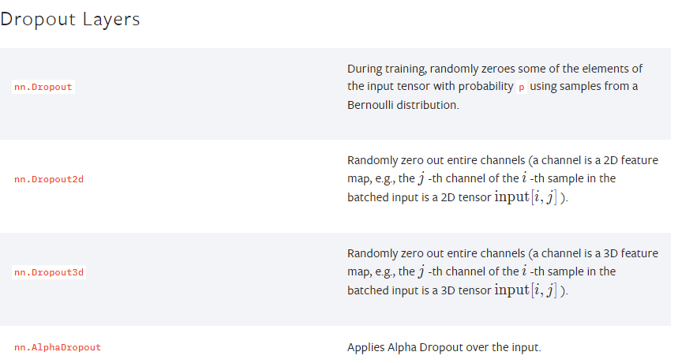
Dropout
Credits: Pytorch documentation.
Notes:
Zero out random neuros, where the randomization occurs at training iteration.
Perturbs features being generated by the model, exerting an effect is close to augmentation but this time for the network.
Placed between the nonlinear acivation function and the linear or conv layer sbsequent.
Note that is dropping out durng training, but in production or test, the dropout is bypassed or equivalently assigned a probability eual to zero.

Slide 12
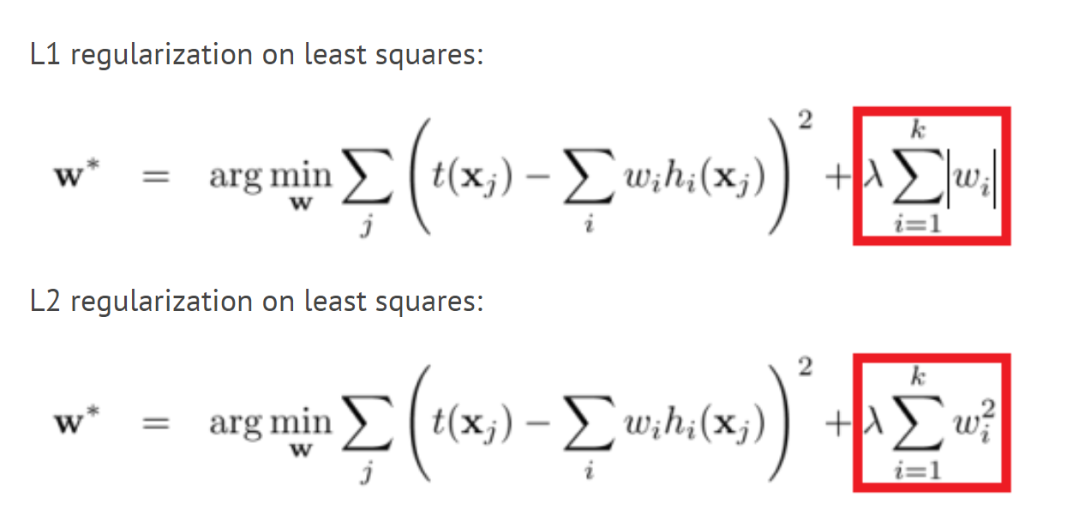
Regularizations
Credits: https://discuss.pytorch.org/t/how-does-one-implement-weight-regularization-l1-or-l2-manually-without-optimum/7951?page=2
Notes:
Zero out random neuros, where the randomization occurs at training iteration.
Perturbs features being generated by the model, exerting an effect is close to augmentation but this time for the network.
Placed between the nonlinear acivation function and the linear or conv layer sbsequent.
Note that is dropping out durng training, but in production or test, the dropout is bypassed or equivalently assigned a probability eual to zero.

Slide 13
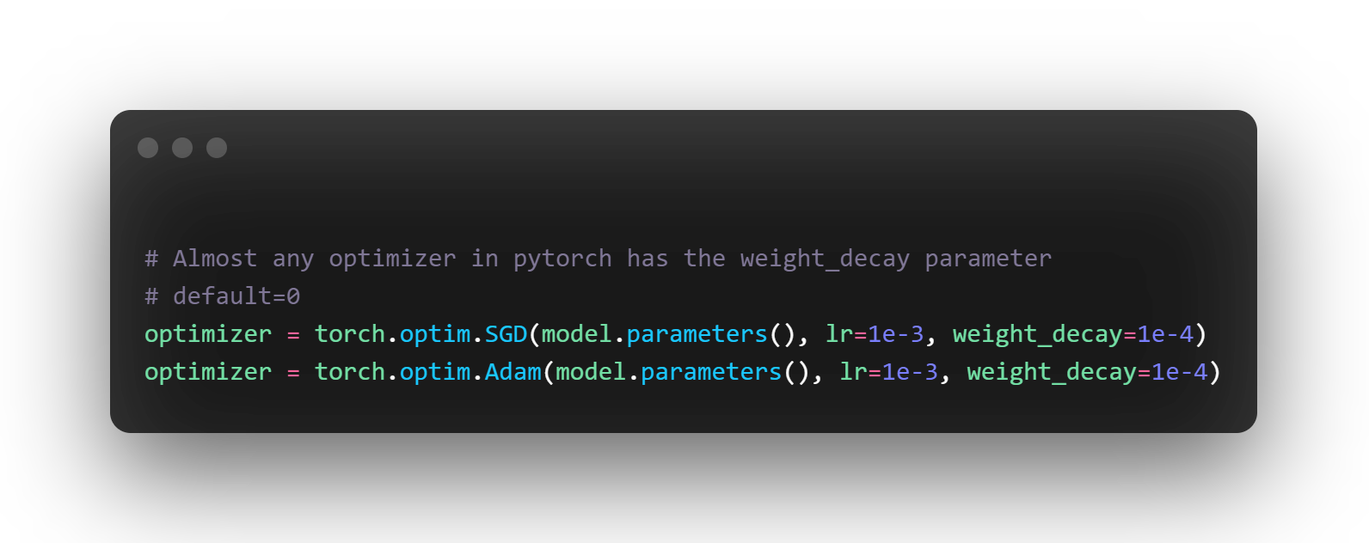
Regularizations
Credits: https://discuss.pytorch.org/t/how-does-one-implement-weight-regularization-l1-or-l2-manually-without-optimum/7951?page=2
Notes:
Zero out random neuros, where the randomization occurs at training iteration.
Perturbs features being generated by the model, exerting an effect is close to augmentation but this time for the network.
Placed between the nonlinear acivation function and the linear or conv layer sbsequent.
Note that is dropping out durng training, but in production or test, the dropout is bypassed or equivalently assigned a probability eual to zero.

Slide 14
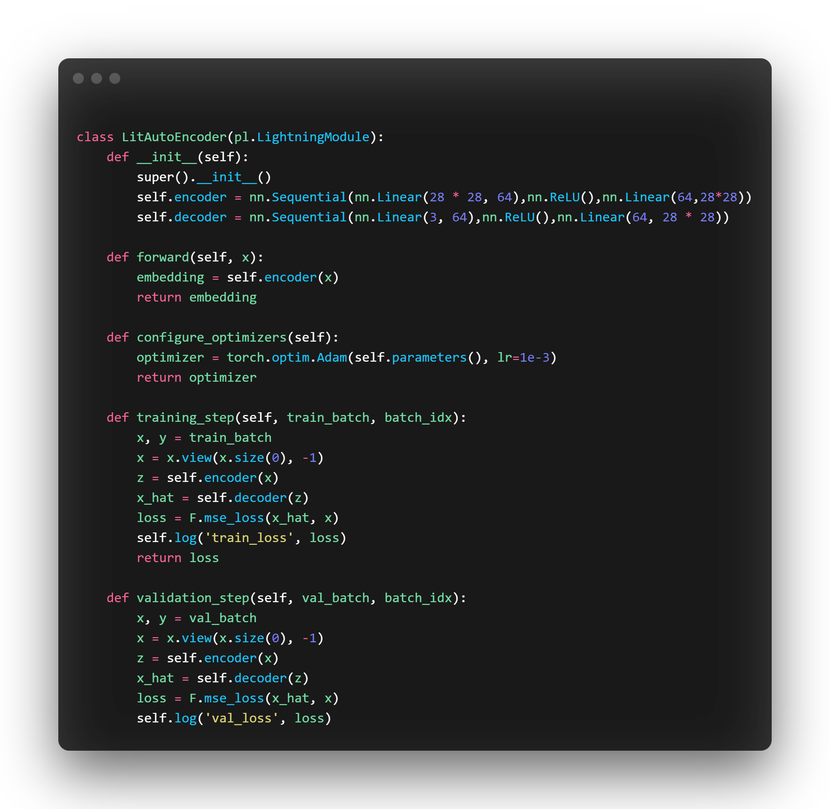
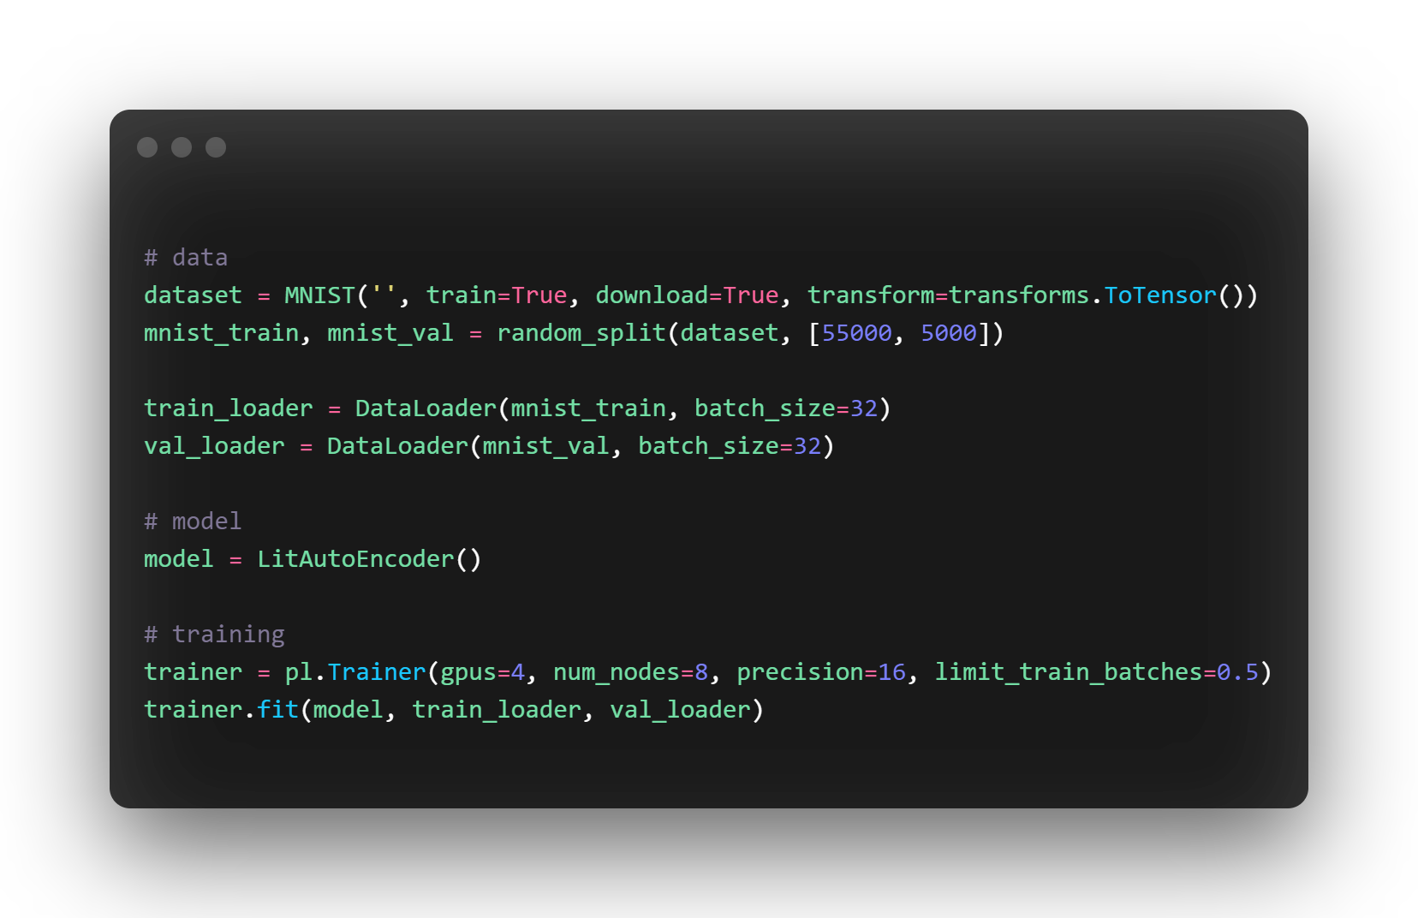
Pytorch-lightning
Build on top of Pytorch.
Less Engineering, more focus on research.
More organized.
Less prone to errors.
Scalable to any hardware without changing your model
Credits: https://www.pytorchlightning.ai

Slide 15


